Slide 1
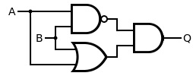

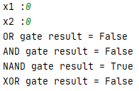
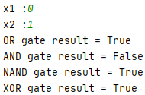
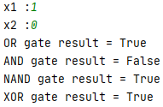
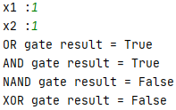
< AND Gate >
< OR Gate >
< NAND Gate >
< XOR Gate >
< XOR Gate >
(0, 0) | (0, 1) | (1, 0) | (1, 1)

